Slide 1
Module - 4

Slide 2
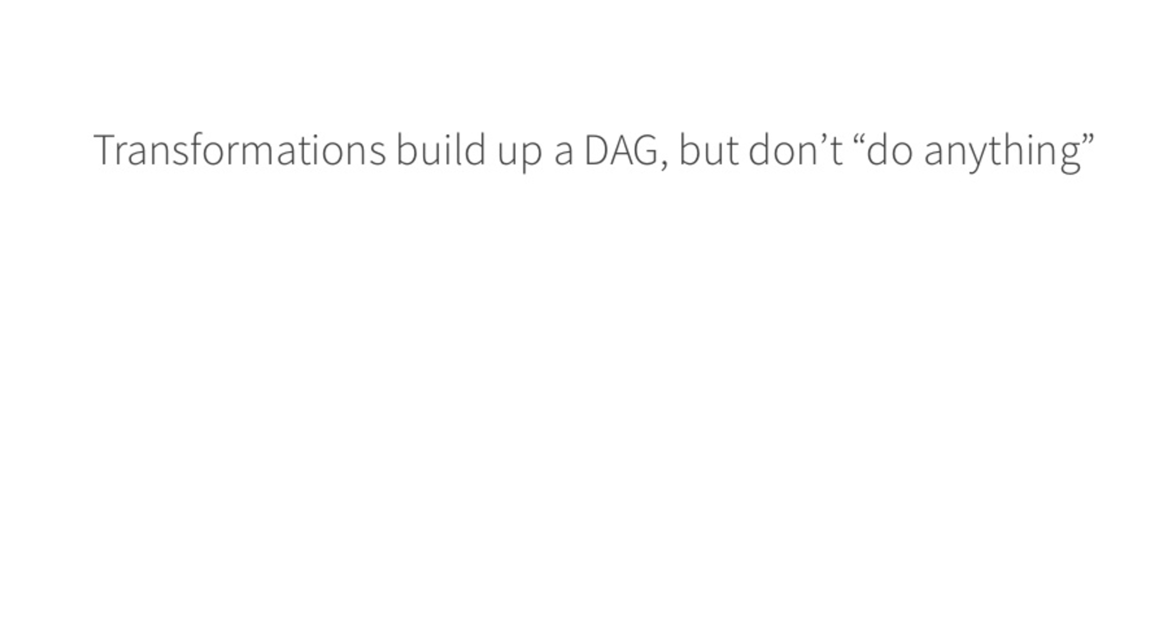

FAST DATA SHARING via - RDD
Fast Data Sharing via RDD (Resilient Distributed Datasets)
RDD - Distributed Memory Abstraction within Spark
Serializable - Compressed
sort & shuffle output - Shuffled RDD, which is processed In Memory
RDD’s always prefer Immutability
DATASET - RDD
DATASET

Slide 3


What is a DAG - Direct Acyclic Graph Depicting LAZY EVAL
Data Input
DAG is persisted
Adds Process P1 to DAG
1
Eg: sc.parallelize or
SC.TextFile
Read DATA
P1
Adds Process P2 to DAG
2
Transformation 1
P2
Eg: Transformative functions like
Filter, map, flatMap etc.
Adds Process P3 to DAG
3
Transformation 2
P3
Runs\Evaluates all Processes in the DAG
as soon as an Action is invoked
Cache
Persist(Disk_only)
ACTION
4
Eg: Aggregate functions like
Count, ReduceByKey,
Collect etc.
P4

Slide 4
SPARK 1.* versions
SparkContext => For Core API’s
sqlContext => For Spark SQL
hiveContext => For Hive Queries
streamingContext => Spark Streaming
SPARK 2.* versions
Spark Session
DataSets
RDD
Creation of a Dataset from a case class
Or
Creation of a Data frame from an RDD\Dataset using a case class
Reflection

Slide 5
Parquet File ➔ Columnar Storage + Metadata information
a b c d
1 2 3 4
5 6 7 8
1 => a (1,5)
2 => b (2,6)
3 => c (3,7)

Slide 6
K-Means Clustering
Cluster 1
Likely
0
Cluster 2
Very Likely
1
Cluster 3
Very Very Likely
2
Cluster 4
Very Very Very Likely
3

Slide 7
LOCAL vs CLIENT vs CLUSTER MODES
Local: Driver + Application – Single/multi Core Application
Client: Driver - Runs on Client machine from which spark app is submitted
while Application runs on Slave machines
Cluster: Driver runs on Cluster on one of the slaves
& App also runs on rest of the slave machines of the cluster
1
Locally as a pgm
Standalone Spark cluster
Hadoop Cluster
Driver
2
Application
Exec2
Exec3
Exec1
2a
2b
2c

Slide 8
Locally as a pgm ➔ No RM
cluster ➔ Spark Standalone Resource Manager
Hadoop Cluster ➔ Yarn ➔ Cluster/
-YARN will start APPMASTER via a NODE Manager
- Appmaster will ask for resources from RM
- RM will release resources
- Appmaster will talk to NM to start separate container which will contain
Spark Driver program
- Driver pgm will hold spark context object
- Spark context object will negotiate with YARN for more resources
via app master
- YARN will release more resources
- App Master will start more containers
- Spark context obj will start executors inside those containers
- Spark Context obj is gonna send the app code to executors
- Spark context obj will start individual tasks to run in parallel running app code
- Spark context obj will monitor all the tasks and will restart the failed tasks
- Once complete all tasks will send the result back to the driver via spark context obj
- Consolidated results given to the user
- Spark context obj will release all resources to app master and stop driver pgm
- Appmaster will deregister itself from YARN

Slide 9
D1
D2
Import spark.sparkContext
BUILDING a Project
Download all dependencies
Compile your code
Create a Jar File
SCALA BUILD TOOL – SBT
MAVEN
GRADDLE
PGM1
Build.sbt

Slide 10
CLIENT & CLUSTER MODES
Spark App 1
Driver
Driver
SparkContext
W1
W2
W3
W4
WORKER NODES

Slide 11
PARTITIONING IN SPARK
W1
W2
File - Blocks 1,2,3
File - Blocks 4,5,6
TextFileRDD
TextFileRDD
P1
P2
P3
P1
P2
P3
P1
P2
P3
T1
T2
T3
T1
T2
T3
PARTITIONS DEPEND ON :
NUMBER OF CORES AVAILABLE
IN CASE OF HDFS FILES, IT DEPENDS ON NUMBER OF BLOCKS IN WHICH FILE IS STORED IN HDFS
RESILIENT BECAUSE: DAG IS PERSISTED, SO WE CAN RECREATE THE LOST RDD FROM DAG
Coalesce (decrease) and re-partition (Increase or decrease)

Slide 12

SHUFFLED RDD’s & LRU processing
shuffled rdd
Doesn't hold any data
until evaluated
shuffled rdd
File 1
RDD
Scala Col
RDD.map(x => (x,1)).
reduceByKey(_+_)
RDD.count()
RDD.collect()
sc.textFile
sc.parallelize
LRU - Least Recently Used
Memory by default
1,5
2,4
7
RDD
7
5
6
1
2
3
DISK
HDFS File => No of Blocks in HDFS
3 Cores => Parallel Tasks

Slide 13
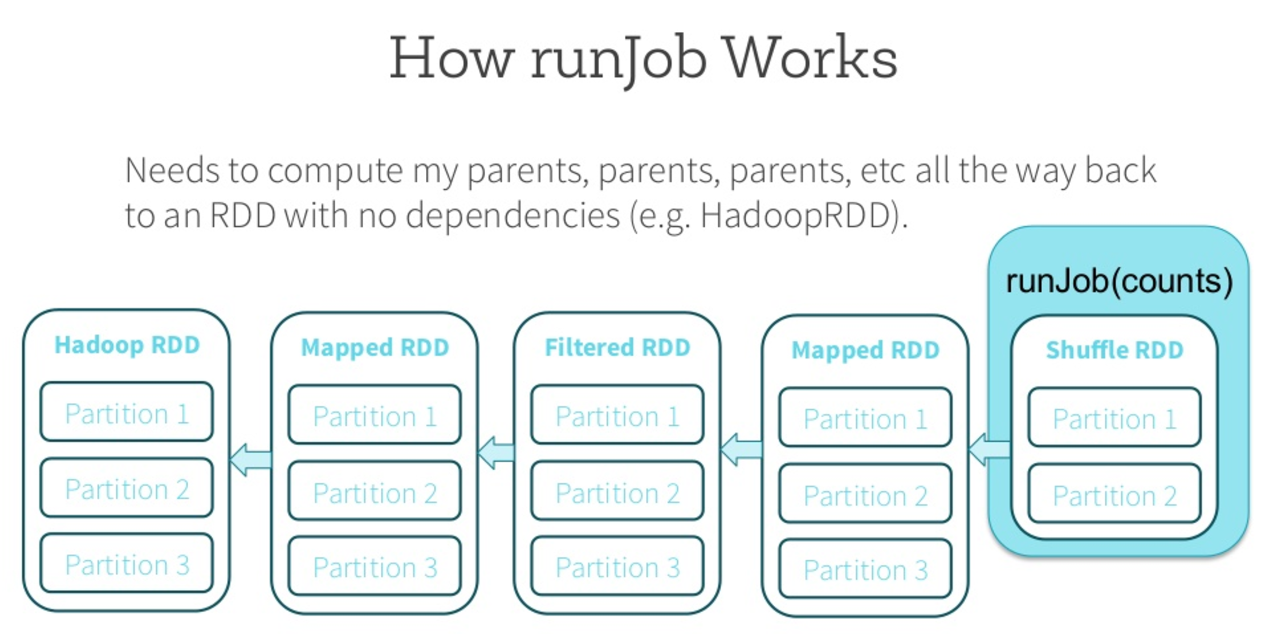
spark jobs and partitioning

Slide 15
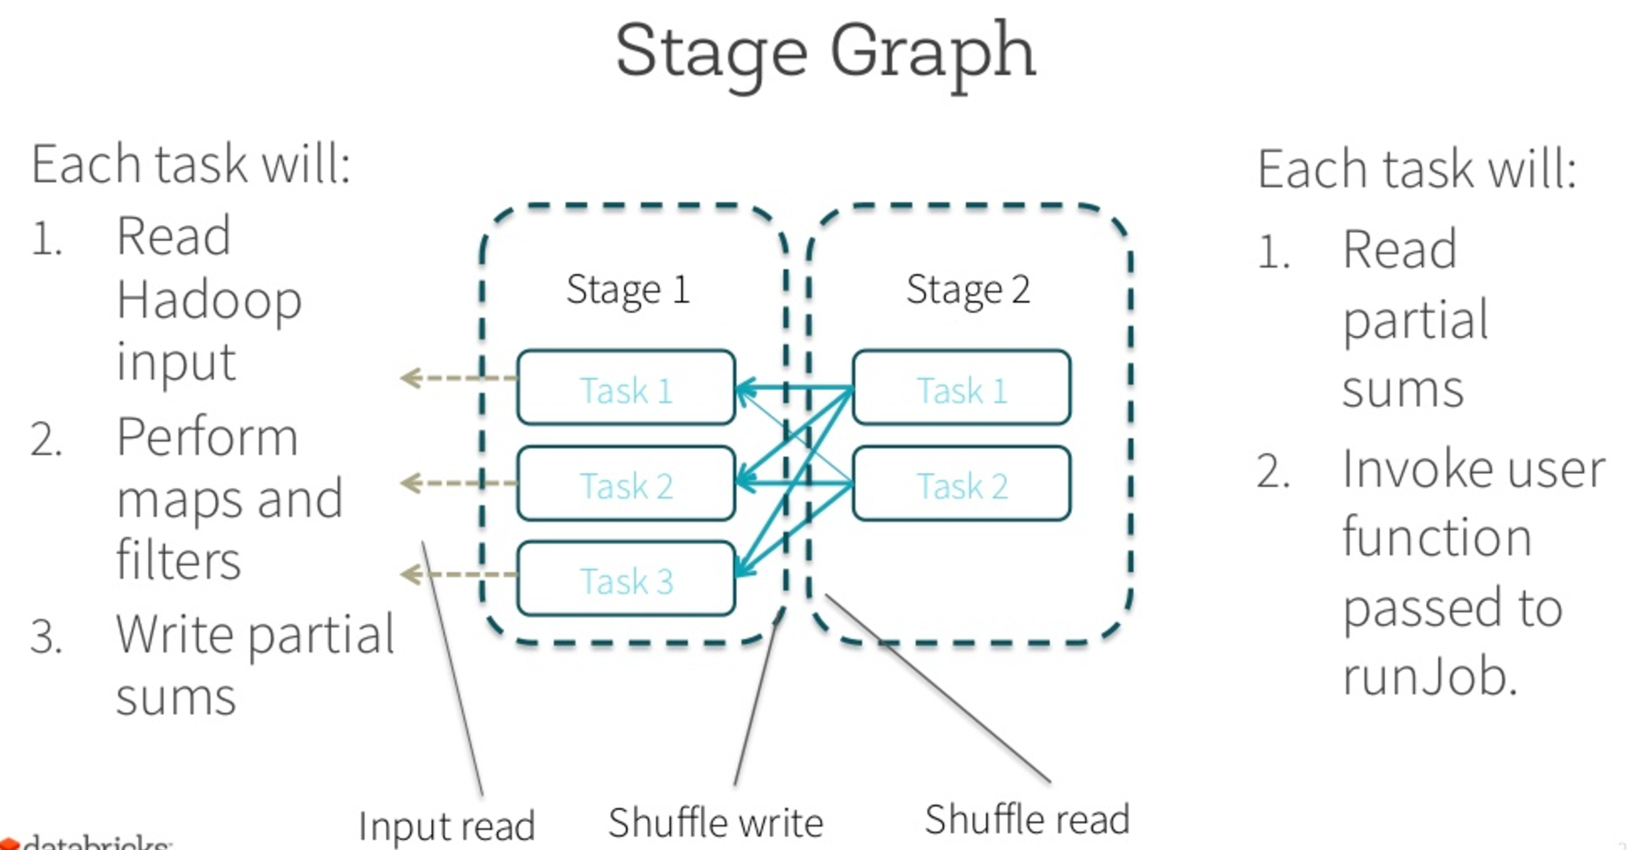
Stage Boundary

Slide 16
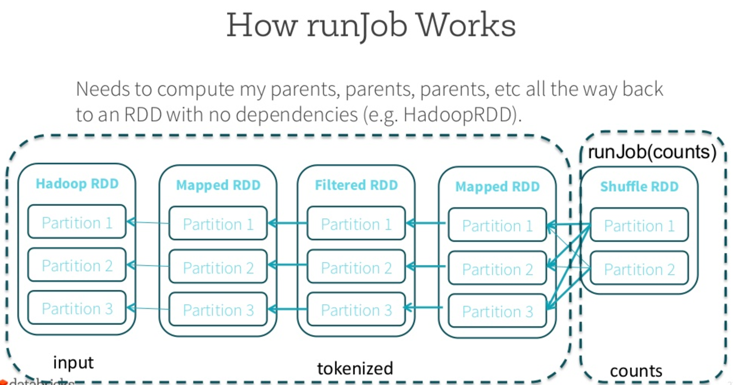

Slide 17
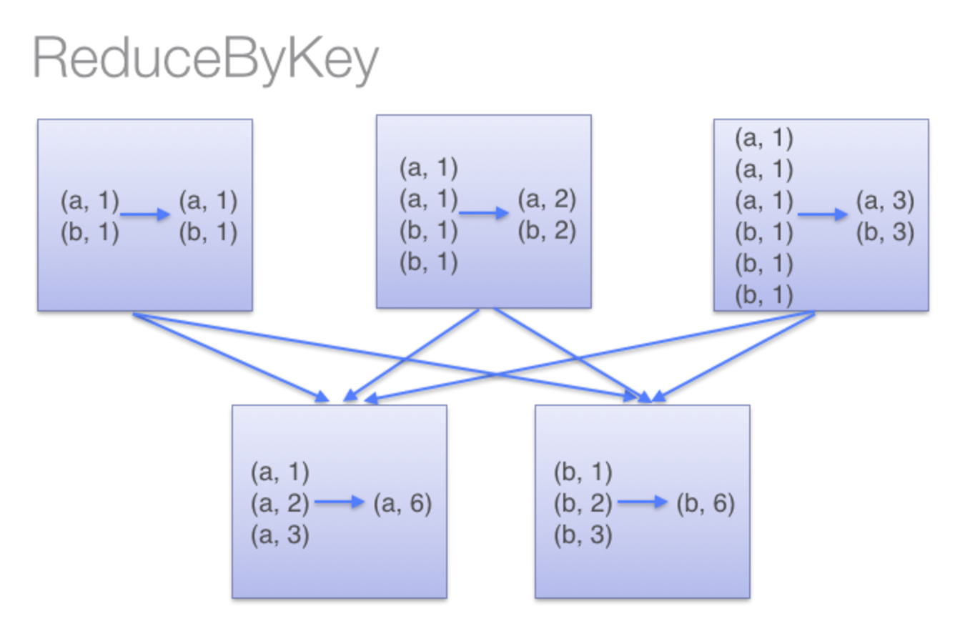
Shuffled RDD
Worker/slave1
ReduceByKey(_ + _)
MAPS
Shuffled RDDs
Sort & Shuffle
Worker2/slave2
REDUCE
RS1
RS2
Shuffled RDDs

Slide 18
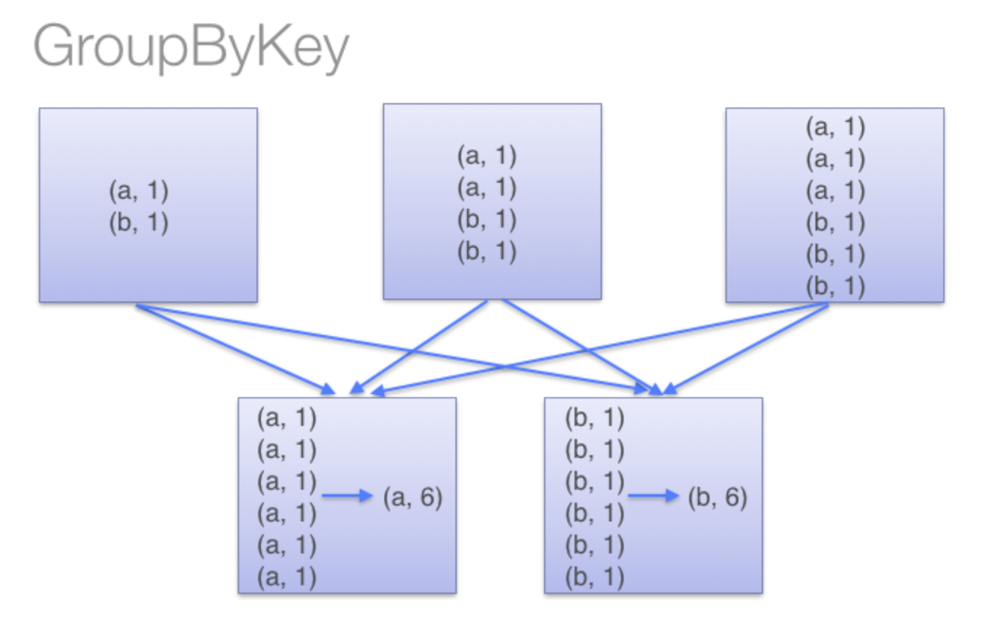
t1
t2
t3
RS1
RS2

Slide 19
Definition of Big Data
Velocity - never stops. Streaming data like Twitter, Facebook, Machine Logs etc.
Volume - Huge sized datasets, table unloads, unstructured logs from various machines etc..
Variety - Text, Videos, Audios, images, likes, logs
Varacity - Incompleteness of Data - always provides approximated results
Max\Min\Avg\Co-variance\variance\Std-deviation - Statistical Inferences
Batch Processing:
End of the day
Non- Real Time
Real Time
OLTP - Online Transaction Processing
OLAP - Online Analytical Processing

Slide 20
In-Memory: - RAM (Main Memory) includes CACHE
Physical Memory: Physical DISK or SSD’s.
Spark does it on its own, for eg: SHUFFLED RDDs, BROADCAST VARIABLES (maintained by spark for applications)
Programmer indicates it, for eg: Cache() & Persist() - RDD’s

Slide 22
PM\MM\Pr
PM\MM\Pr

Slide 23
JOB1 - Get Data
JOB2 - Process & generate o/p
MAP\REDUCE
U1
U1
4 PM - 5 AM
BATCH
U4
U4
RDBMS
Mainframe
Autosys\TWS
RDBMS
U2
U2
U1
U3
U3
U4
RDBMS
U2
U3

Slide 24
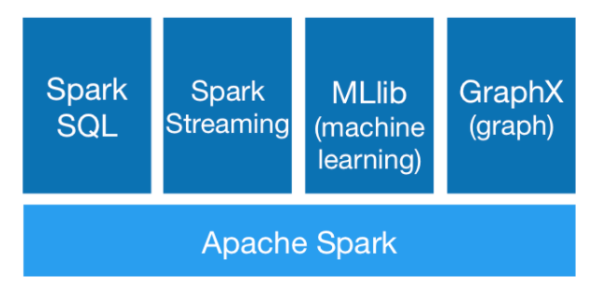
What is Spark?
Apache Spark™ is a fast and general engine for large-scale data processing.
It guarantees:
SPEED: Run programs up to 100x faster than Hadoop MapReduce in memory, or 10x faster on disk.
Apache Spark has an advanced DAG execution engine that supports cyclic data flow and in-memory computing.
EASE OF USE: Write applications quickly in Java, Scala, Python, R. Spark offers over 80 high-level operators that make it easy to build parallel apps. And you can use it interactively from the Scala, Python and R shells.
GENERALITY: Combine SQL, streaming, and complex analytics. Spark powers a stack of libraries including SQL and DataFrames, MLlib for machine learning, GraphX, and Spark Streaming. You can combine these libraries seamlessly in the same application.
RUNS EVERYWHERE: Spark runs on Hadoop, Mesos, standalone, or in the cloud. It can access diverse data sources including HDFS, Cassandra, HBase, and S3.

Slide 25
SPARK with Scala
SCALA doc for available SPARK Libraries
https://spark.apache.org/docs/preview/api/scala/index.html#package

Slide 26
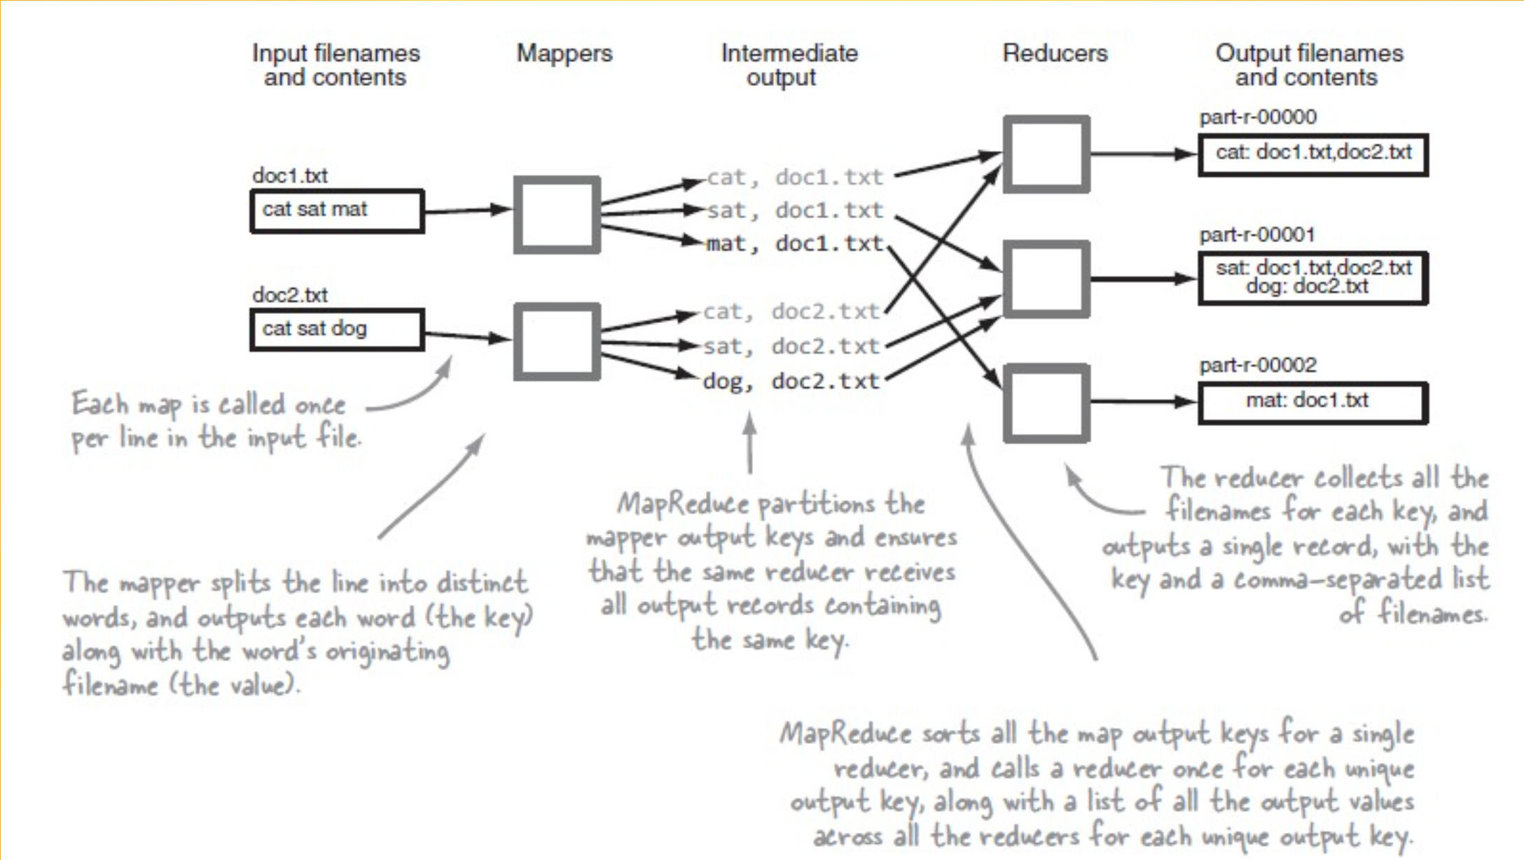
Map Reduce Architecture

Slide 27
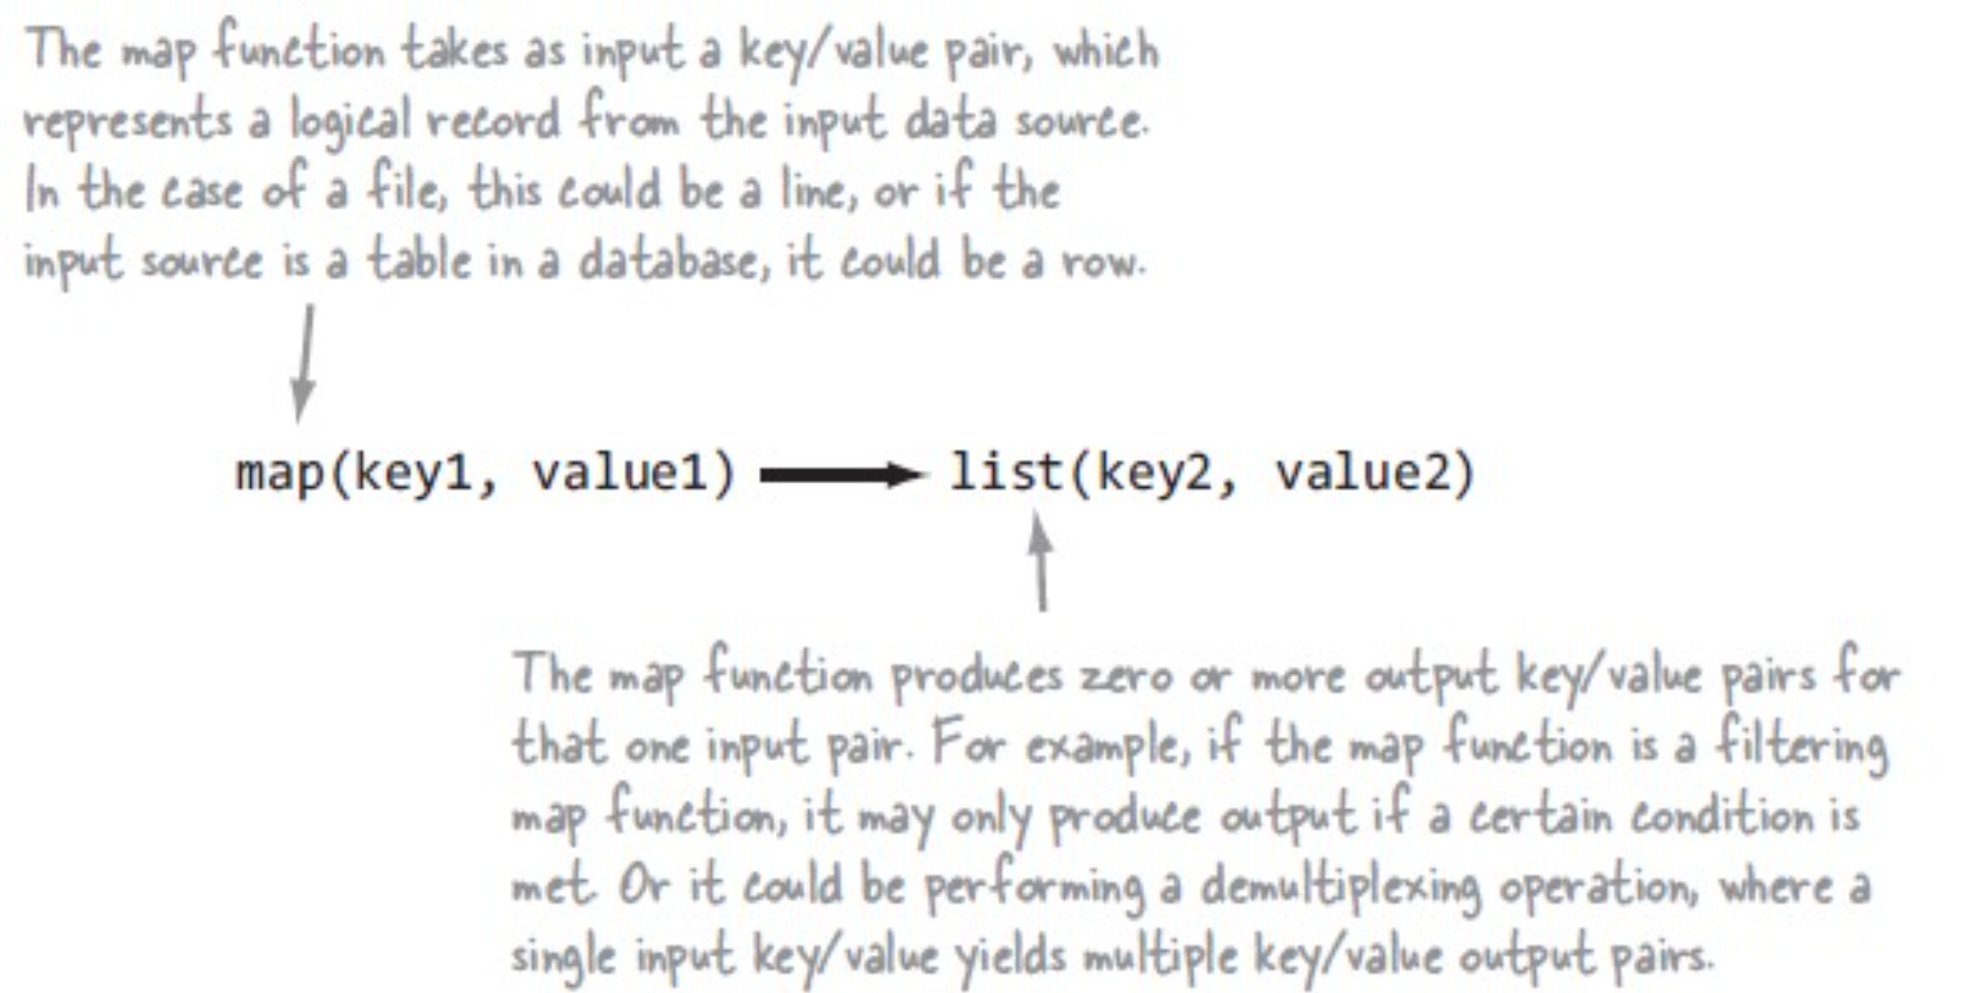
Map Output

Slide 28
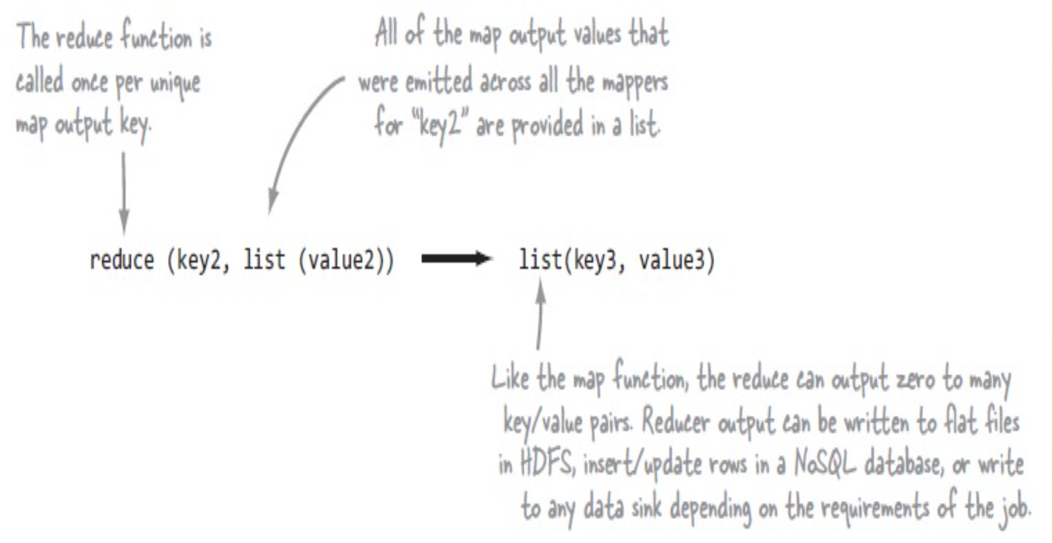
Reducer Output

Slide 29
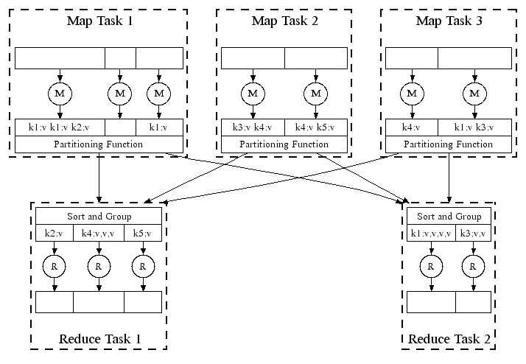
Parallel Execution
Notes:
View from scheduled m/c perspective

Slide 30
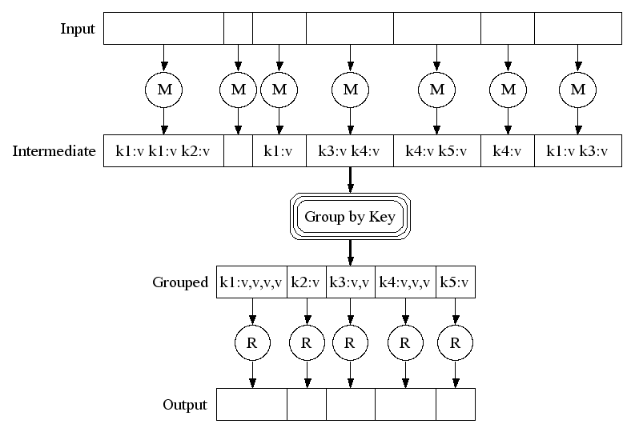
Map Reduce Execution
Notes:
View from task perspective

Slide 31
Array[(Int, Int)] = Array((1,1), (2,1), (3,1), (1,1), (2,1), (3,1), (2,1), (2,1), (2,1))
Map((3,1) -> 2, (2,1) -> 5, (1,1) -> 2)

Slide 32
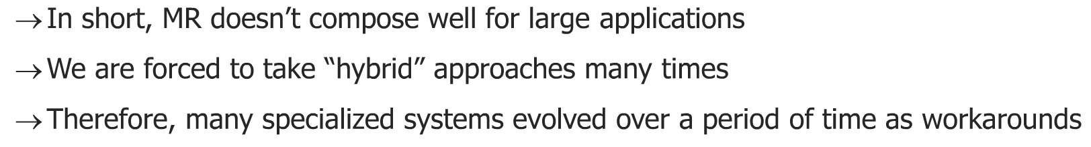
Map Reduce Limitations
Difficult to Program an algo in Native Map Reduce
Not good for low latency processing as:
Lots of Disk I\O
Processing in Stages: Reducer cant start until Mapper is complete
Not fit for small batch.
Many categories of algos not supported or are very difficult to implement: For e.g., the ones which need iterations
The problem of “stragglers” (slow workers)
Other jobs consuming resources on machine
Bad disks with soft errors transfer data very slowly
Weird things: processor caches disabled (!!)

Slide 33
RDD is: Resilient Distributed DataSet
— Smallest unit of Abstracted data set in spark
— it is partitioned so that it can be worked upon in parallel
—- Transformation: Processes which transform an RDD into a new RDD
—- Action: Actual Evaluations which gives back results
Persist(StorageLevel.Memory_Only)
Cache -> Always In Memory
Persist -> This can be In Memory or Disk or Both

Slide 34
setMaster(Local): Runs your application locally in the machine
setMaster(Local[2]):Run Locally but its gonna spawn 2 threads for my application.
setMaster(Local[*]):Run Locally but its gonna spawn * threads for my application depending on available number of cores in my machine.
Client: setMaster(spark://localhost.localdomain:7077) -> Standalone cluster mode
mesos: setMaster(mesos://1.2.3.4)
setMaster(Yarn): To run your application on Hadoop Cluster
Properties properties Application Program
SPARK-SUBMIT <properties set-up dynamically>
SPARK-DEFAULTS.conf ==> Uses default properties
Edge Node - Entry point for the users into hadoop
locally run on edge node with local mode

Slide 35
W1
a = 1
b = 1
c = 1,
c = 1,
a = 1
b = 1
reduceByKey() =>
(a,2),
(b,2),
(c,2
T1 T2 T3
W2
a = 1
b = 1
c = 1,
c = 1,
a = 1
b = 1
reduceByKey() =>
(a,2),
(b,2),
(c,2
T4 T5 T6
groupByKey()
Shuffle
(a,4),(b,4),(c,4)

Slide 36
Dependencies
SBT
Scala Build Tool
maven
P1
Byte Code
Compile => SCALAC
JAR
SBT eclipse
JVM
MAVEN
GRADDLE
IVY
SCALA BUILD TOOL

Slide 37
build.sbt
sbt compile
sbt package
sbt eclipse
Step 1: Download all dependencies via SBT
& Compile your program
Step 2: You create a package\jar via SBT
step3: Creating eclipse view of application

Slide 38
Rdd.persist
Transformations
Filter1
Filter2
Map
Reduce
Collect
HDFS
Filter1
Filter2
Map
COGROUP

Slide 39
Hadoop input format :
IntWritable extends serializable <iterable>
eg: Mapper class (<IntWritable>,<>,<>,<>
)
Sequence File: saveAsSequence(“<HDP file name>”)
Kyro serializer

Slide 40
Module - 4

Slide 41
SPARK
Scala
REPL
./bin/spark-shell
Python
REPL
./bin/pyspark
JAVA
NO
REPL
N\A
R
REPL
./bin/sparkR

Slide 42
SparkContext
Entry Point of ur spark pg.
Negotiates for resources with Resource Manager (YARN, Spark Standalone cluster Manager, Mesos CM)
Starts Executors
Sends application code base to each executor
Starts the Tasks inside executors
Monitors the tasks until their lifetime and re-starts the tasks if necessary
Consolidates the results and gives it back to the user and stops the app

Slide 43
Module - 5

Slide 44
Worker Node Architecture - with HDFS
Worker 1
Worker 2
Persistance
Layer
Persistance
Layer
EXECUTOR - JVM process
CACHE
EXECUTOR - JVM process
CACHE
Task1
Task2
Task3
Task4
RDD -1
RDD -2
DISK
RDD -3
RDD -4
DISK
Partitioning Scheme - default = no. of HDFS blocks (default is 64 MB)
Partitioning Scheme - default = no. of HDFS blocks (default is 64 MB)
HDFS
HDFS
BLOCK -1
BLOCK -2
BLOCK -3
BLOCK -4

Slide 45
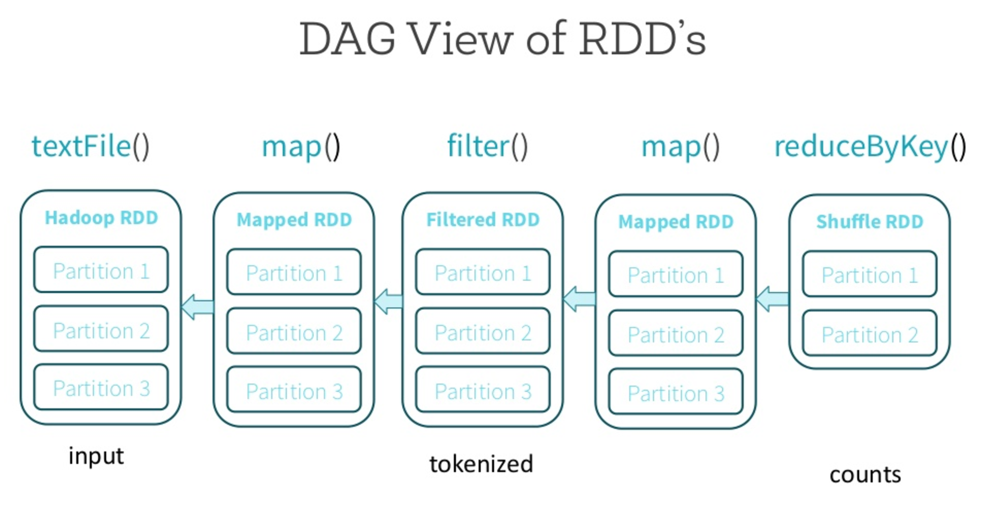

Slide 46
Worker1
D1
RDD-P1
RDD-P2
HDFS - Blocks of data 128MB - 10 BLOCKS
No. of cores in your worker
Re-partitioning

Slide 47
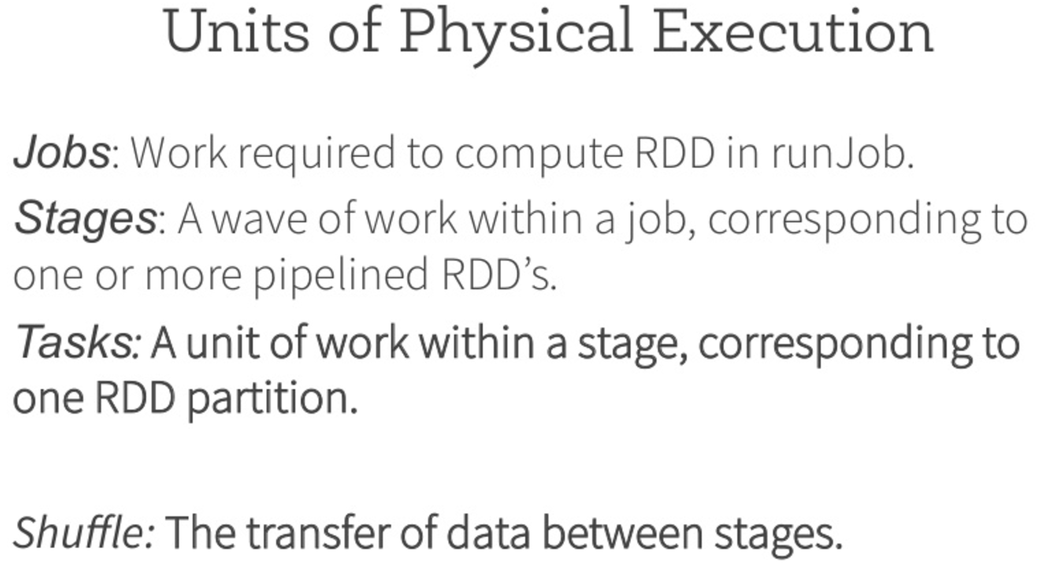

Slide 48
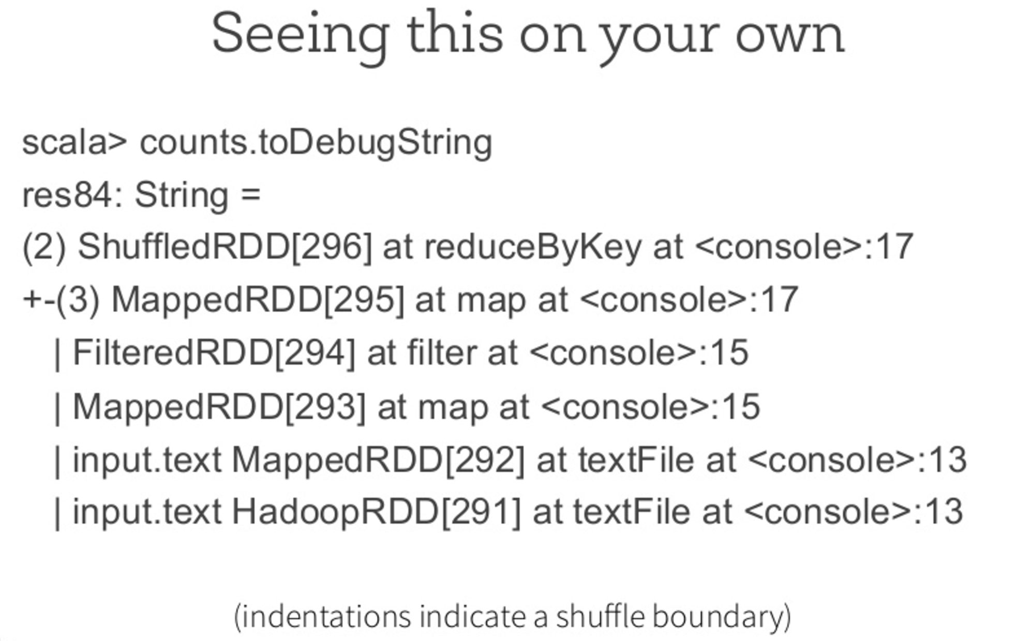

Slide 49
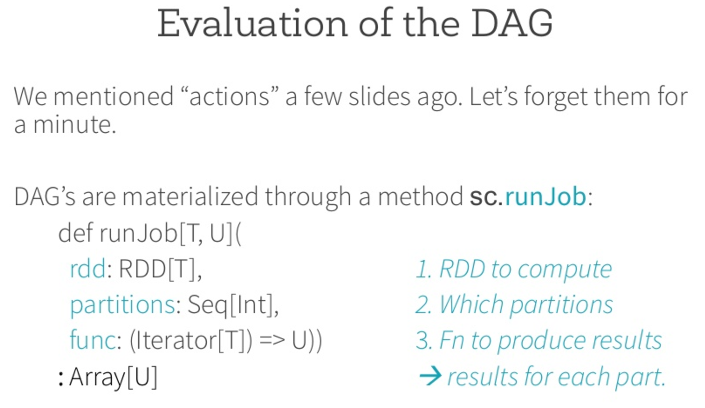

Slide 50
Coalesce(<decreased no of partitions>)
repartition(<Increase or decrease no of partitions>)
2 tasks per core => 16 for cores
coalesce(<decrease no of partirions>)

Slide 51
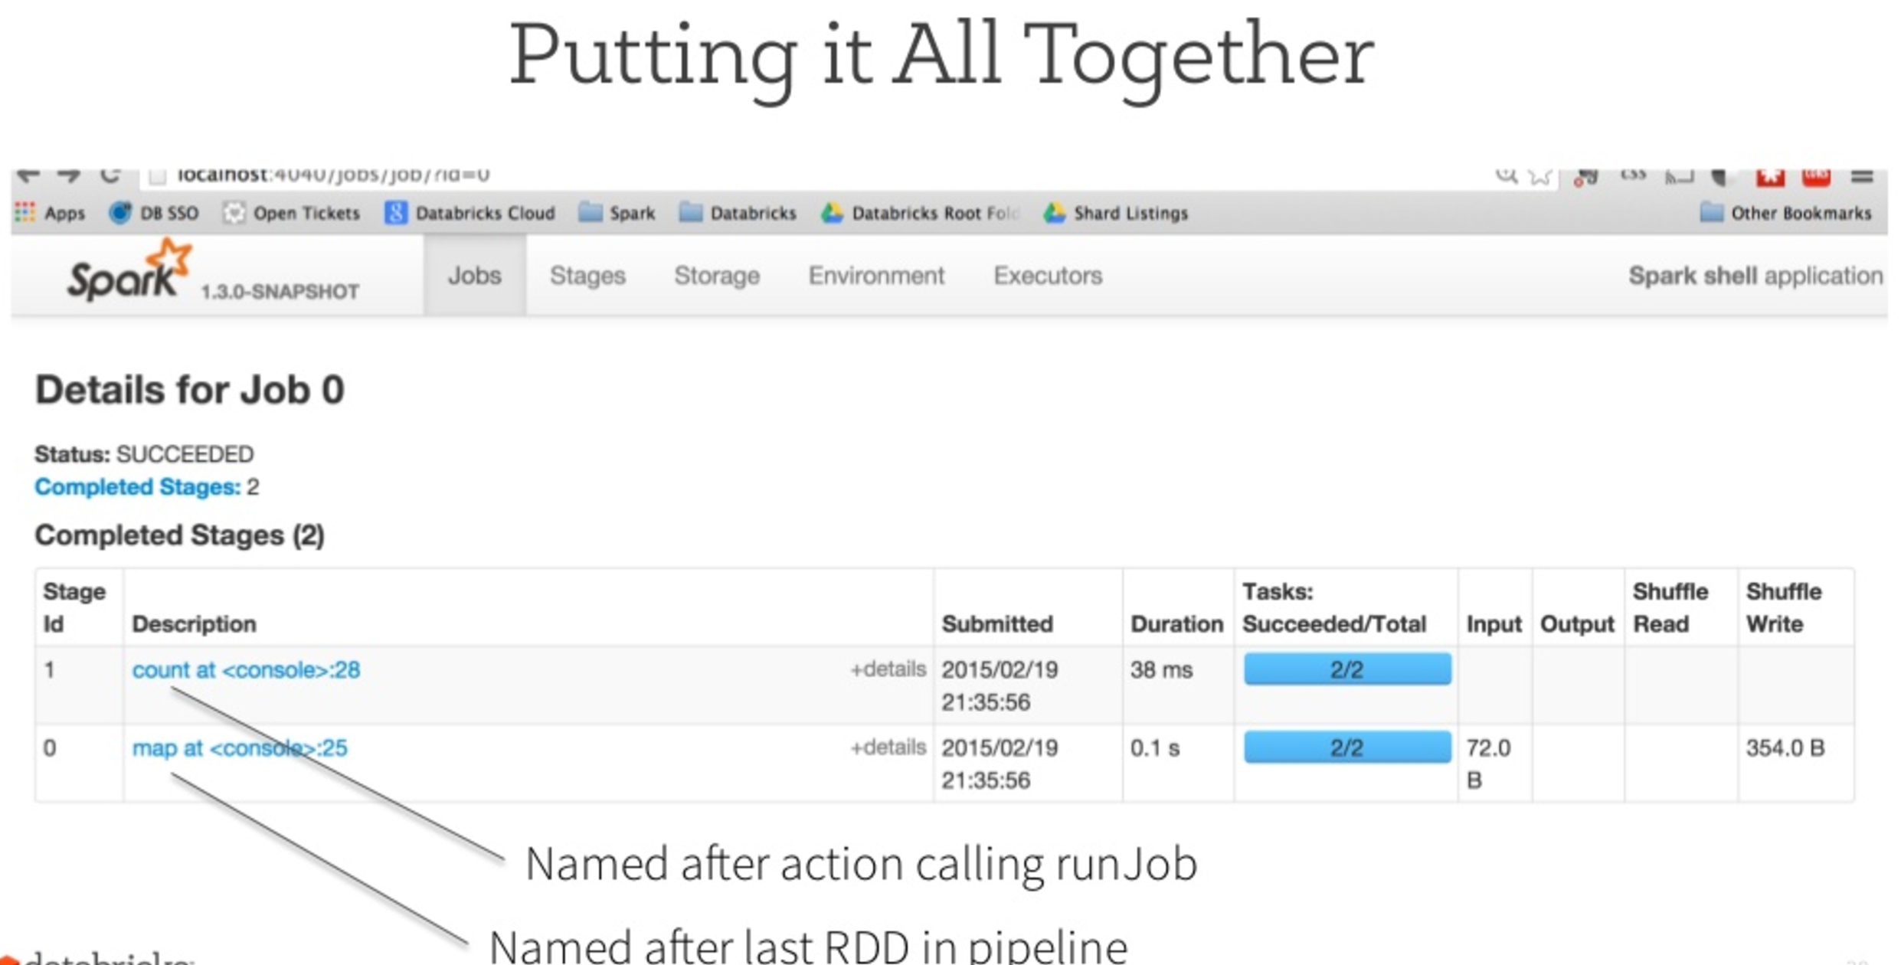

Slide 52
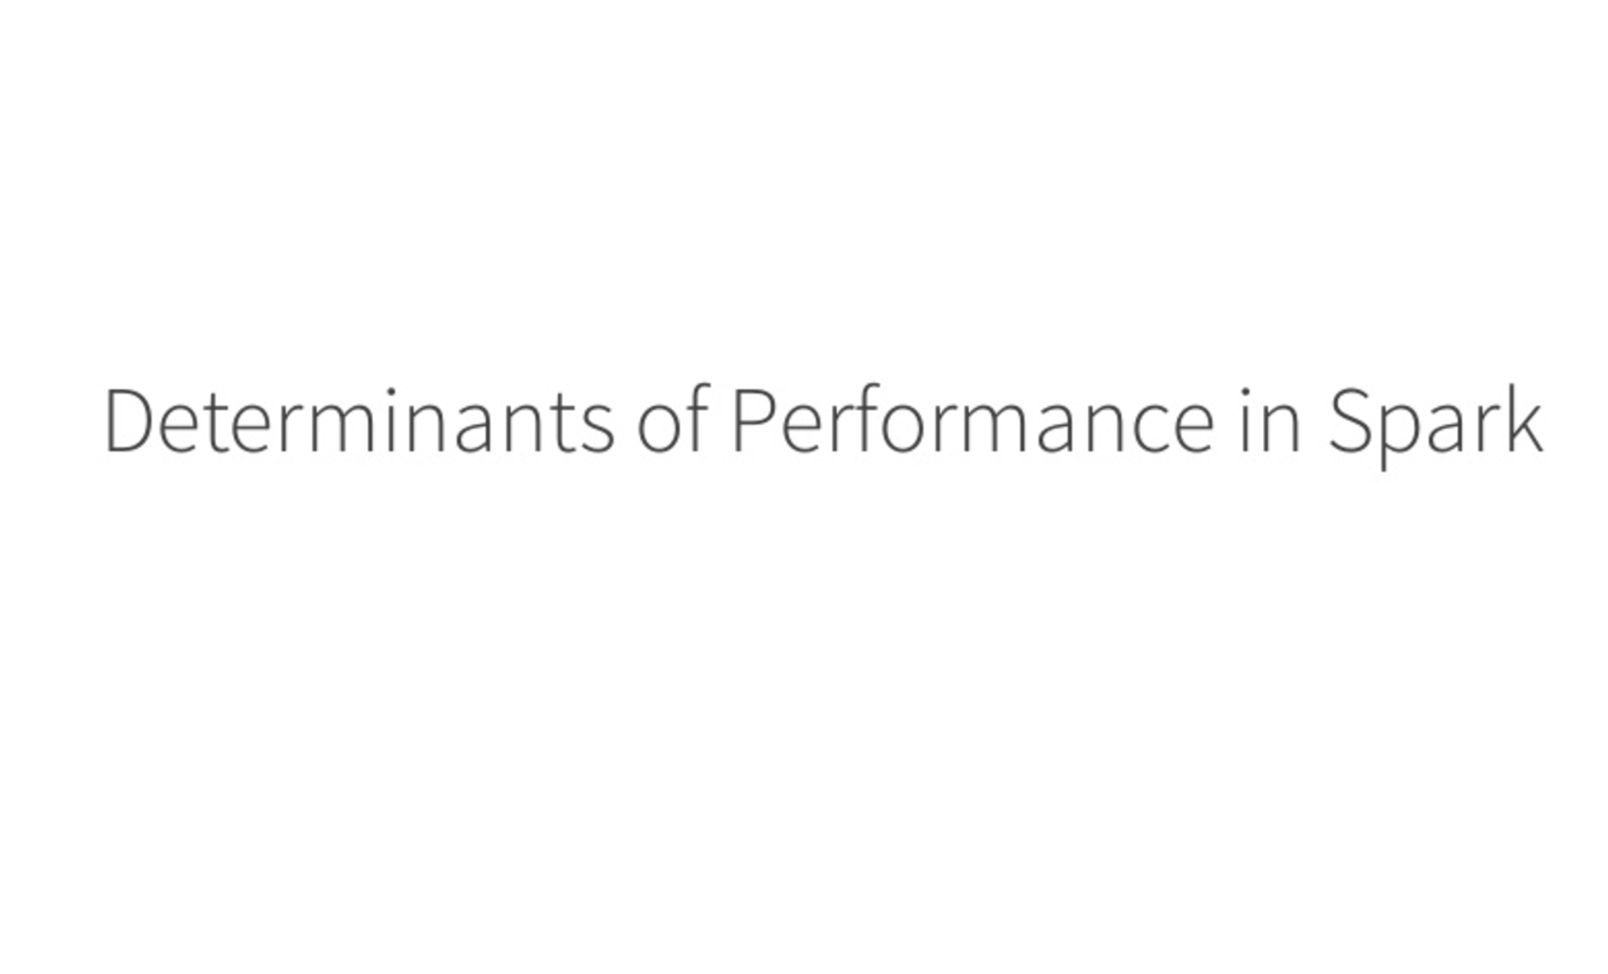

Slide 53
Sequence file
(K,V) : Where V is always serialised
Hadoop Input Format: implements IntWritable Interface
CLASS ==> Object
MAPPER\Reducer CLASS implements IntWritable
: By default the objects created out of this class will be serializable (hadoop custom serialization)
Output of Hadoop Processing:When you write
these serialized objects of (K,V)
pair in a file, that file is called “Sequence File”

Slide 54
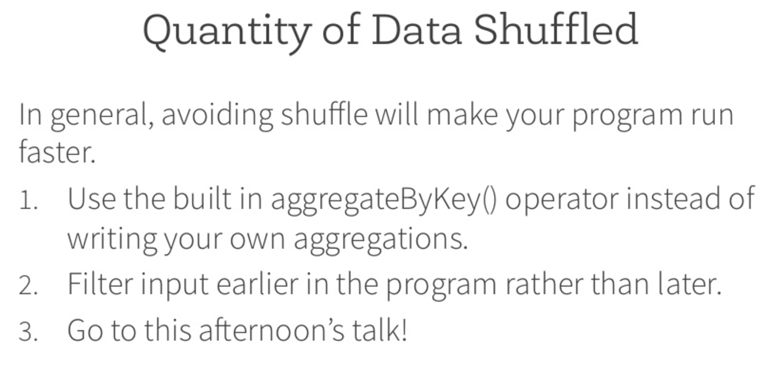

Slide 55
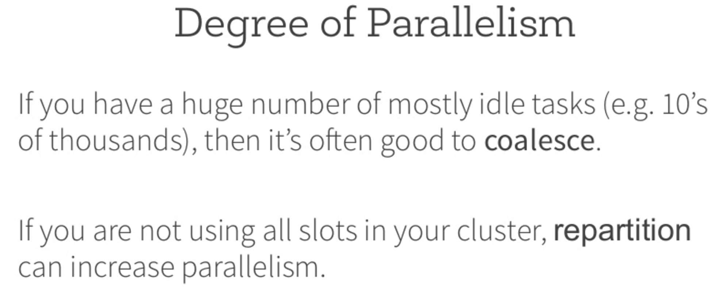

Slide 56
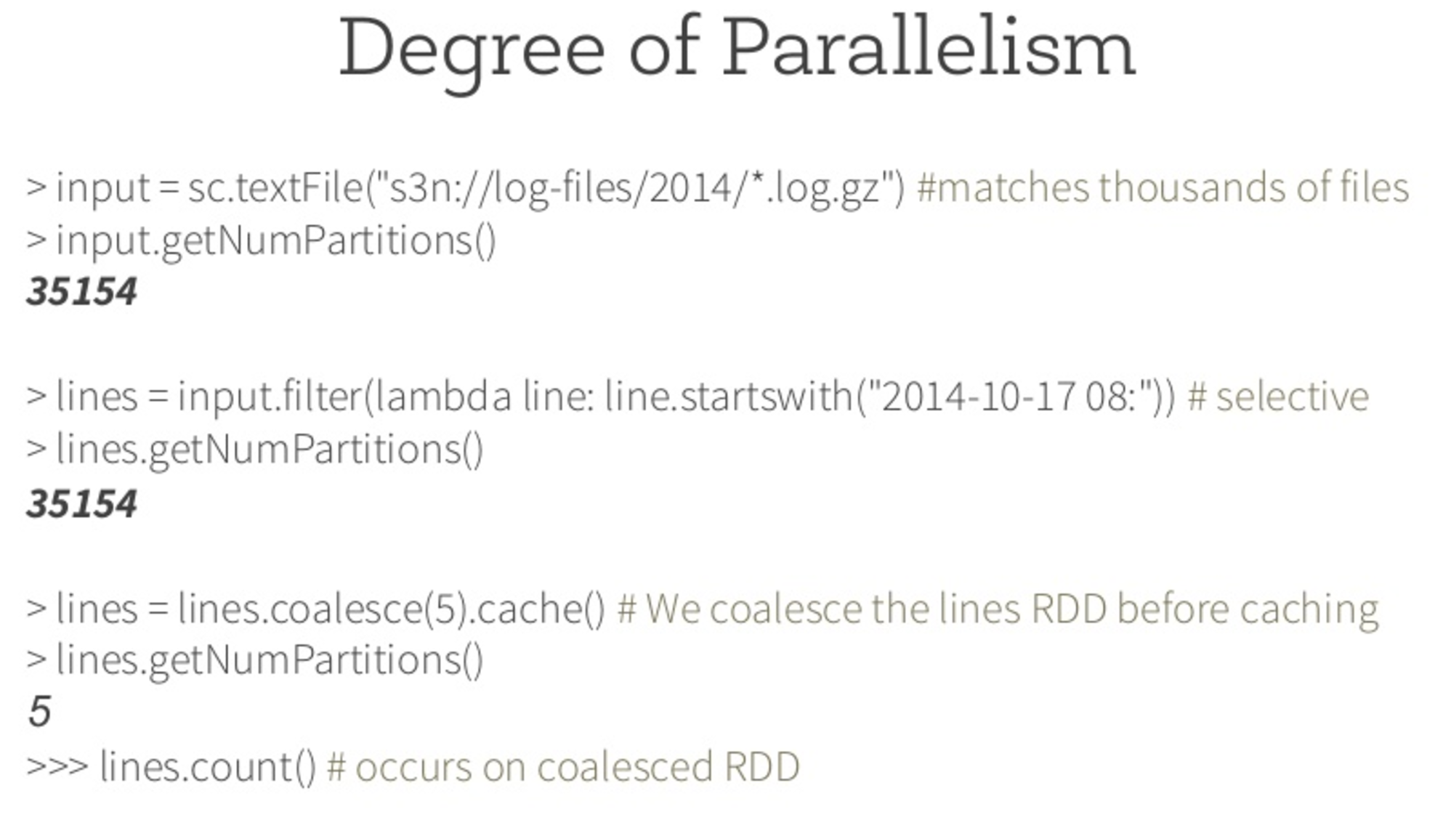

Slide 57
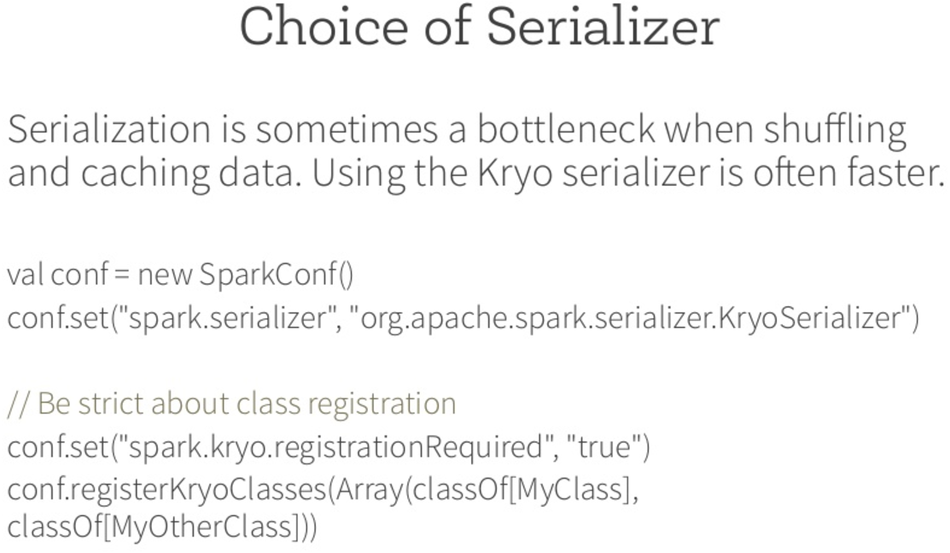

Slide 58
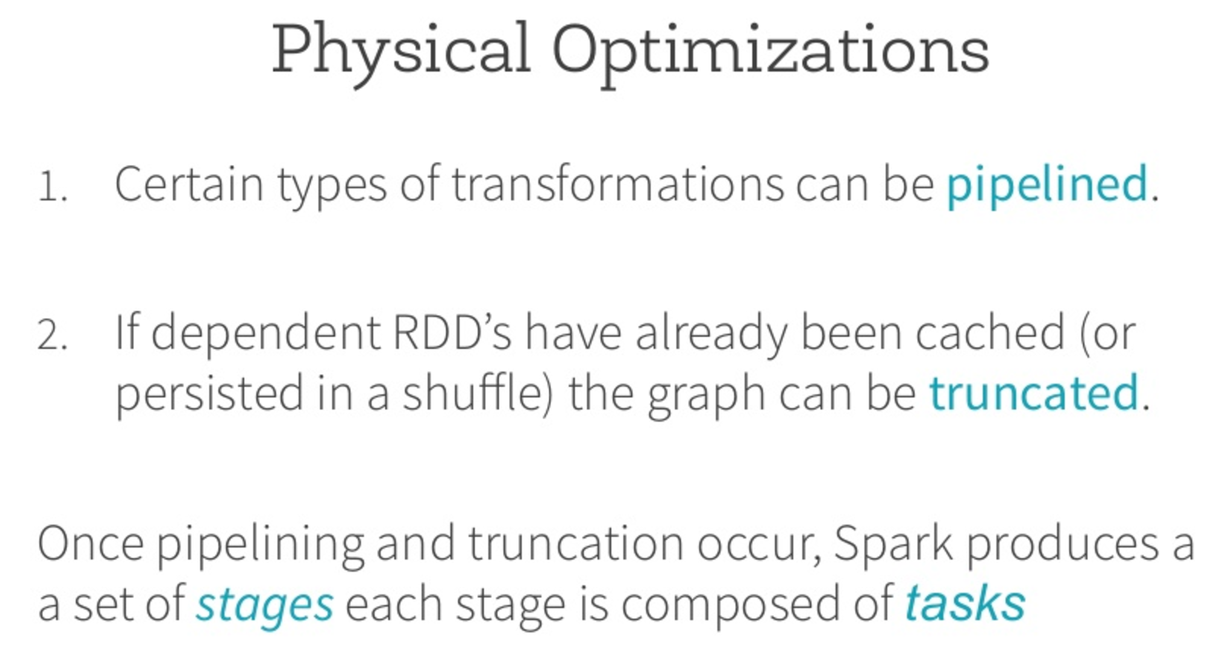

Slide 59
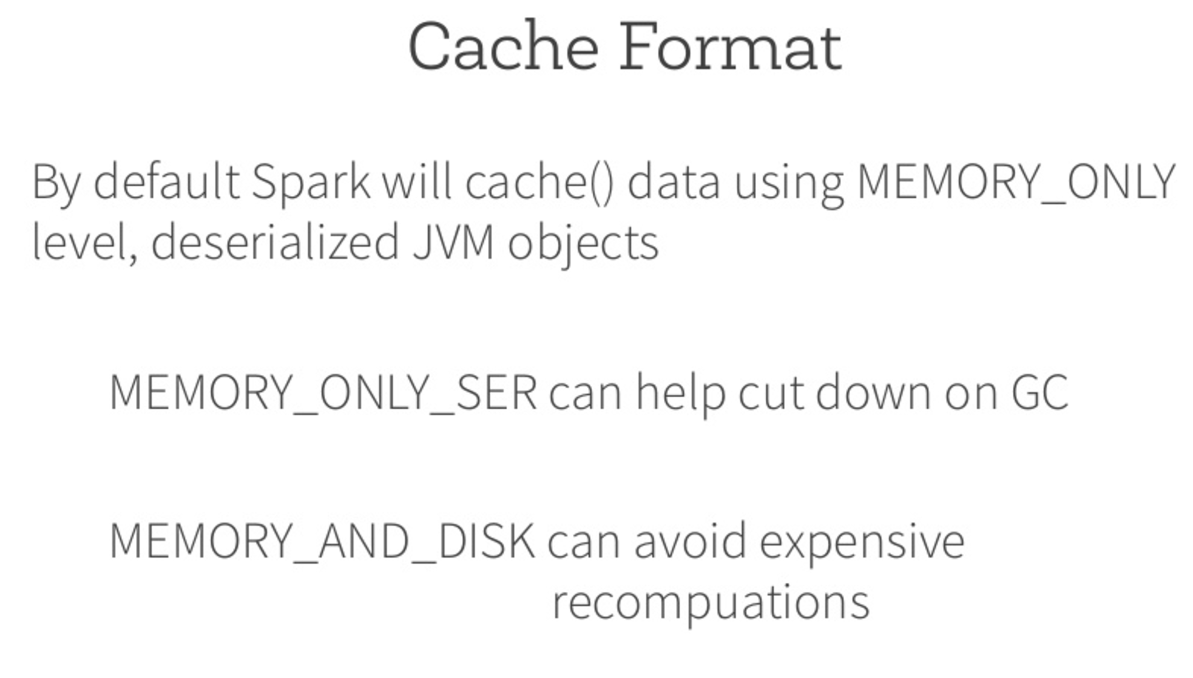

Slide 60
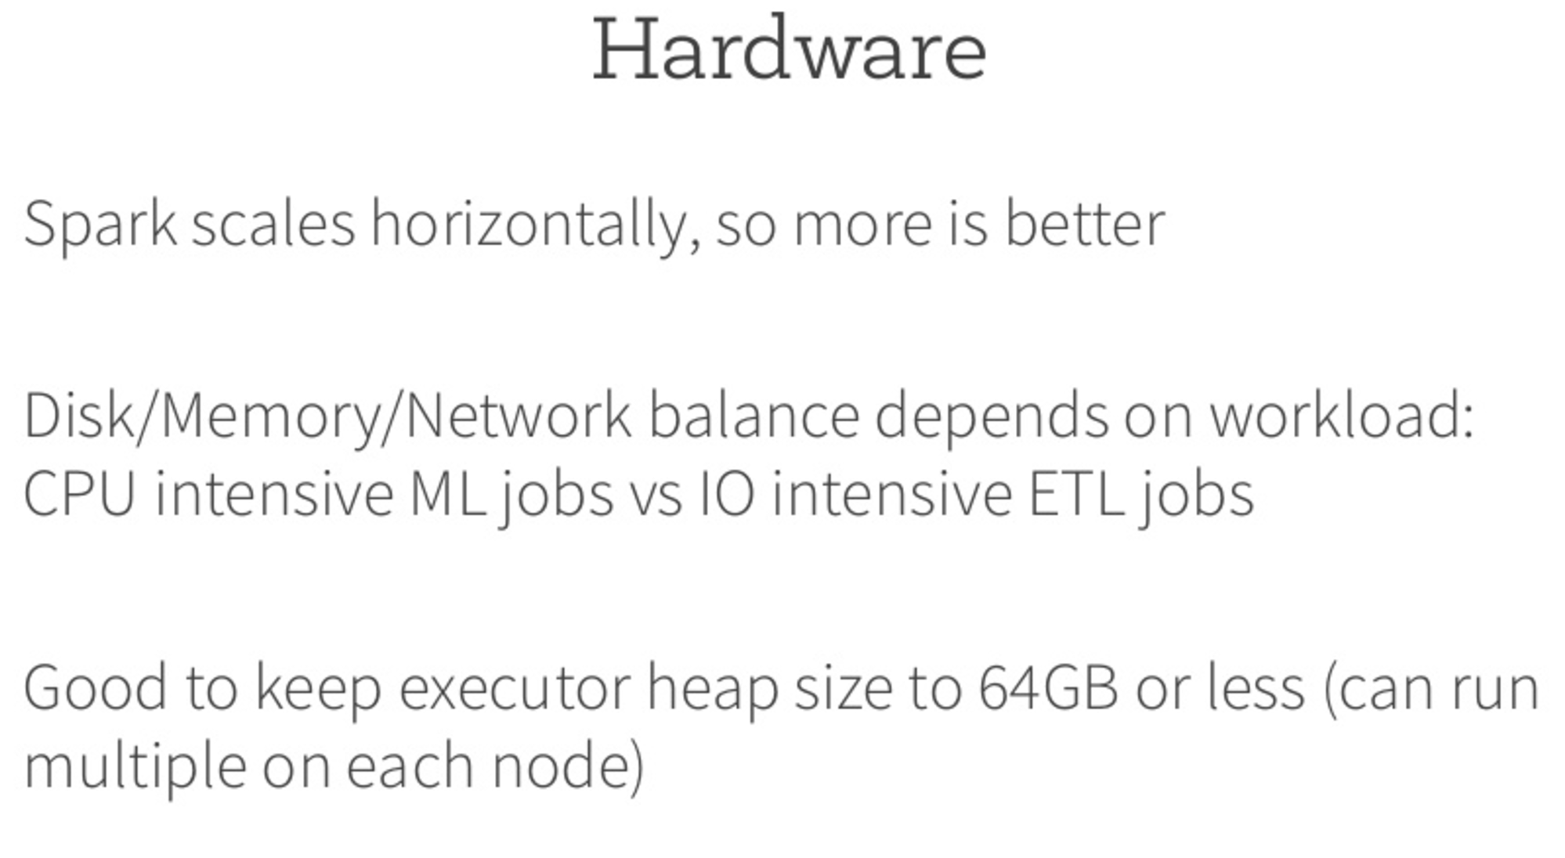

Slide 61


Slide 62
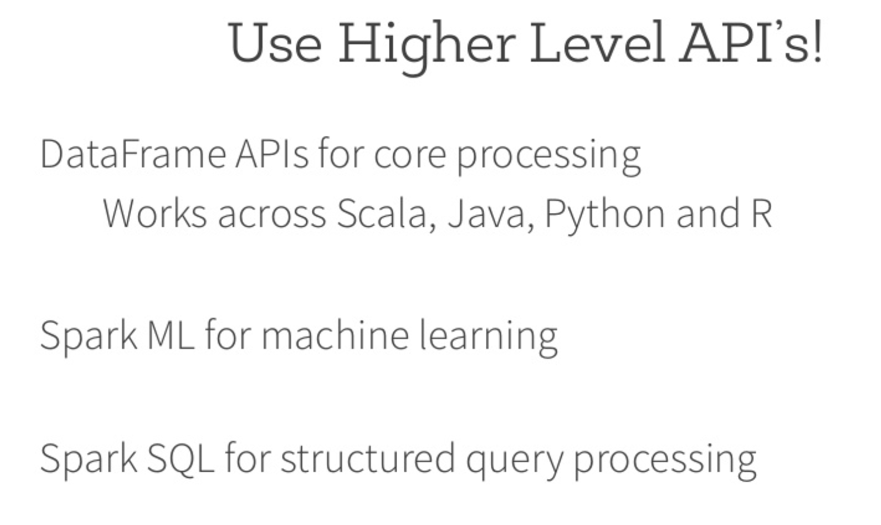

Slide 63
Running spark in local mode
vs standalone cluster mode
SPARK in Standalone cluster mode
./bin/spark-submit --class "RDDRelation" --master spark://Ashishs-MacBook-Pro.local:7077 ./Programs1/target/scala-2.10/Spark-Project_2.10-1.0.jar
./bin/spark-submit --class "SimpleApp" --master spark://Ashishs-MacBook-Pro.local:7077 ./Programs/target/scala-2.10/simple-project_2.10-1.0.jar (to run in standalone cluster mode provide the uri of master displayed on master ui)
SPARK in Local Mode
./bin/spark-submit --class "RDDRelation" --master local[4] ./Programs1/target/scala-2.10/Spark-Project_2.10-1.0.jar
./bin/spark-submit --class "SimpleApp" --master local[4] ./Programs/target/scala-2.10/simple-project_2.10-1.0.jar
• if port 4040 is already occupied with some process how to check it: netstat -an | grep "LISTEN“
killing a process in mac:
• netstat -an | grep "LISTEN “
• lsof -i tcp:4040 (this will find the pid for tcp process running on port 4040
• kill -9 <PID>

Slide 64
Important classes\Objects & Functions in SPARK
CLASSES:
SPARKCONF: Configuration for a Spark application. Used to set various Spark parameters as key-value pairs.
Most of the time, you would create a SparkConf object with new SparkConf(), which will load values from any spark.* Java system properties set in your application as well. In this case, parameters you set directly on the SparkConf object take priority over system properties.
All setter methods in this class support chaining. For example, you can write new SparkConf().setMaster("local").setAppName("My app").
Note that once a SparkConf object is passed to Spark, it is cloned and can no longer be modified by the user. Spark does not support modifying the configuration at runtime.
https://spark.apache.org/docs/preview/api/scala/index.html#org.apache.spark.SparkConf
SPARKCONTEXT: Main entry point for Spark functionality. A SparkContext represents the connection to a Spark cluster, and can be used to create RDDs, accumulators and broadcast variables on that cluster.
Only one SparkContext may be active per JVM. You must stop() the active SparkContext before creating a new one. This limitation may eventually be removed.
https://spark.apache.org/docs/preview/api/scala/index.html#org.apache.spark.SparkContext

Slide 65
Important classes\Objects & Functions in SPARK
continued…
SQLContext: The entry point for working with structured data (rows and columns) in Spark 1.x. As of Spark 2.0, this is replaced by SparkSession. However, we are keeping the class here for backward compatibility.
https://spark.apache.org/docs/preview/api/scala/index.html#org.apache.spark.sql.SQLContext
RDDs: Resilient Distributed Datasets:- Spark revolves around the concept of a resilient distributed dataset (RDD), which is a fault-tolerant collection of elements that can be operated on in parallel.
There are two ways to create RDDs: parallelising an existing collection in your driver program,
sc.parallelize(data)
One important parameter for parallel collections is the number of partitions to cut the dataset into. Spark will run one task for each partition of the cluster. Typically you want 2-4 partitions for each CPU in your cluster. sc.parallelize(data, 2)
Referencing a dataset in an external storage system, such as a shared filesystem, HDFS, HBase, or any data source offering a Hadoop InputFormat.
RDD Operations:
Transformation: Transformations, which create a new dataset from an existing one. All transformations in spark are lazy.
eg:
val lines = sc.textFile("data.txt")
val lineLengths = lines.map(s => s.length) ===> Transformation
Action: On the other hand, reduce is an action that aggregates all the elements of the RDD using some function and returns the final result to the driver program (although there is also a parallel reduceByKey that returns a distributed dataset) e.g.: val result = lineLengths.reduce((a,b) => a+b)
PERSIST & CACHE: By default, each transformed RDD may be recomputed each time you run an action on it. However, you may also persist an RDD in memory using the persist (or cache) method, in which case Spark will keep the elements around on the cluster for much faster access the next time you query it. eg: lineLengths.persist()

Slide 66
Important classes\Objects & Functions in SPARK
continued…
Datasets: A Dataset is a strongly typed collection of domain-specific objects that can be transformed in parallel using functional or relational operations. Each Dataset also has an untyped view called a DataFrame, which is a Dataset of Row.
https://spark.apache.org/docs/preview/api/scala/index.html#org.apache.spark.sql.Dataset
Shared Variables:
Problem of Closures in Spark:
To ensure well-defined behavior in these sorts of scenarios one should use an Accumulator. Accumulators in Spark are used specifically to provide a mechanism for safely updating a variable when execution is split up across worker nodes in a cluster.
Eg: val accum = sc.longAccumulator("My Accumulator")
sc.parallelize(Array(1, 2, 3, 4)).foreach(x => accum.add(x))
Broadcast Variables: Spark actions are executed through a set of stages, separated by distributed “shuffle” operations. Spark automatically broadcasts the common data needed by tasks within each stage. The data broadcasted this way is cached in serialized form and deserialized before running each task. This means that explicitly creating broadcast variables is only useful when tasks across multiple stages need the same data or when caching the data in deserialized form is important.
eg:
scala> val broadcastVar = sc.broadcast(Array(1, 2, 3))
scala> broadcastVar.value (displays res0: Array[Int] = Array(1, 2, 3))

Slide 67
Spark MLlib
MLlib is Apache Spark's scalable machine learning library.
Its goal is to make practical machine learning scalable and easy. It consists of common learning algorithms and utilities which include:
classification,
regression,
clustering,
collaborative filtering
dimensionality reduction etc.
as well as lower-level optimization primitives and higher-level pipeline APIs.
Key Highlights:
- Ease of Use: Usable in Java, Scala, Python, and R.
MLlib fits into Spark's APIs and interoperates with NumPy in Python (as of Spark 0.9) and R libraries (as of Spark 1.5). You can use any Hadoop data source (e.g. HDFS, HBase, or local files), making it easy to into Hadoop workflows.
- Performance: 100X times faster than legacy MAP-REDUCE
Spark excels in iterative computation enabling MLlib to run fast.
- Easy to Deploy: Runs on existing Hadoop clusters and data.

Slide 68
Spark GRAPHX
GraphX is a graph library that runs on top of Apache Spark. Developers can use the languages and tools they are familiar with using for Spark to implement new types of algorithms that require the modelling of relationships between objects.
Graph processing is the backbone for many real-world applications, such as:
Social Networks: Users of social networks like Facebook and LinkedIn have one or (hopefully) more "friends" or "connections". These sites use graphs to model relationships between users, and run algorithms on these graphs to suggest new connections to users.
Networking: Data networking, the internet is built from hundreds of thousands of routers, connected together will millions of links. Graph algorithms help determine the best path to use to send data from one user to another.
Astrophysics: Researchers use graphs to model the relationships between planets and galaxies to assist with discovery and classification.
Until recently, developers had to choose a language and library that was either optimized for graphs or for traditional table data. However, many use cases require that developers have access to both simultaneously. For instance, a recommendation algorithm may take a social graph as one input and a table of product ratings as another. Furthermore, the developer writing that recommendation algorithm may want to take care of standard machine learning clustering algorithms like k-Means.
GraphX and Spark provide a comprehensive platform to solve these kinds of problems. By adding a library of graph functions (GraphX) and a library for machine learning (MLlib) to a platform that understands table data (Spark, Shark), developers can seamlessly develop algorithms that take advantage of all functionality at once.

